Slide 1

Online Fees Payment

Slide 2
Facts and Information
The fees can be paid online using following modes:
Credit Card (Master / VISA / RuPay)
Debit Card (Master / VISA / RuPay)
Internet Banking
Please ensure that you have a stable internet connection while making the payment online
Please do not press refresh / back button while making the payment at any point during transaction
Please remember to take the print out / Save the receipt no at the end of transaction for future reference
You can also view the receipt from Online portal later on
Please do not share your user id and Password with any one
Please Note: DPS does not store any banking related information on its website

Slide 3
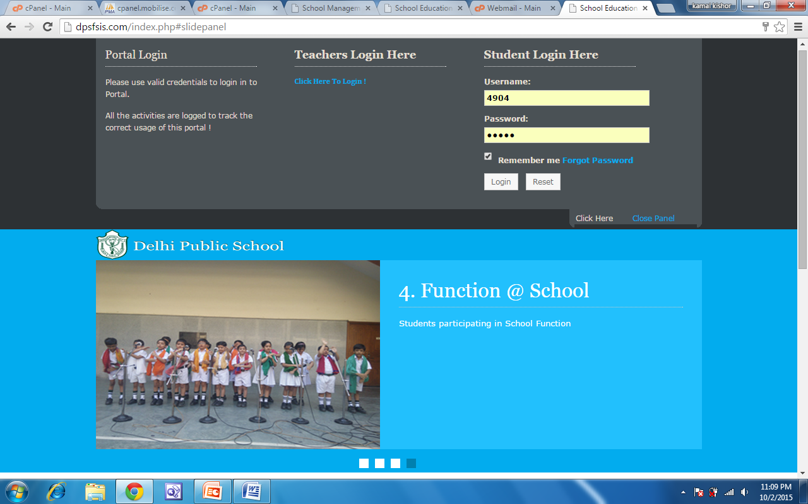
how to use online fees payment facility
Step:1 Go to Website www.dpsfbd.info and enter user name password
Enter UserName
Enter Password
Notes:
The organizational benefits of global human resources translate into:
Improves business insight: Embedded and predicitive analytics improves business insight and decision making
Improves compliance: Being able to adapt to constant changing regulations in different countries improves compliance.
Increases Employee Engagement: When HR service delivery is improved, employee engagement increases
Increases Agility: Organizational and complaince changes are constant and an organization needs to be agile to adapt to all these changes
Increases data accuracy: Eliminating disparate HRMS systems and consolidating the HRMS system will decrease maintenance cost and increase data accuracy
Gain operational excellence and compliance with global human resources.

Slide 4
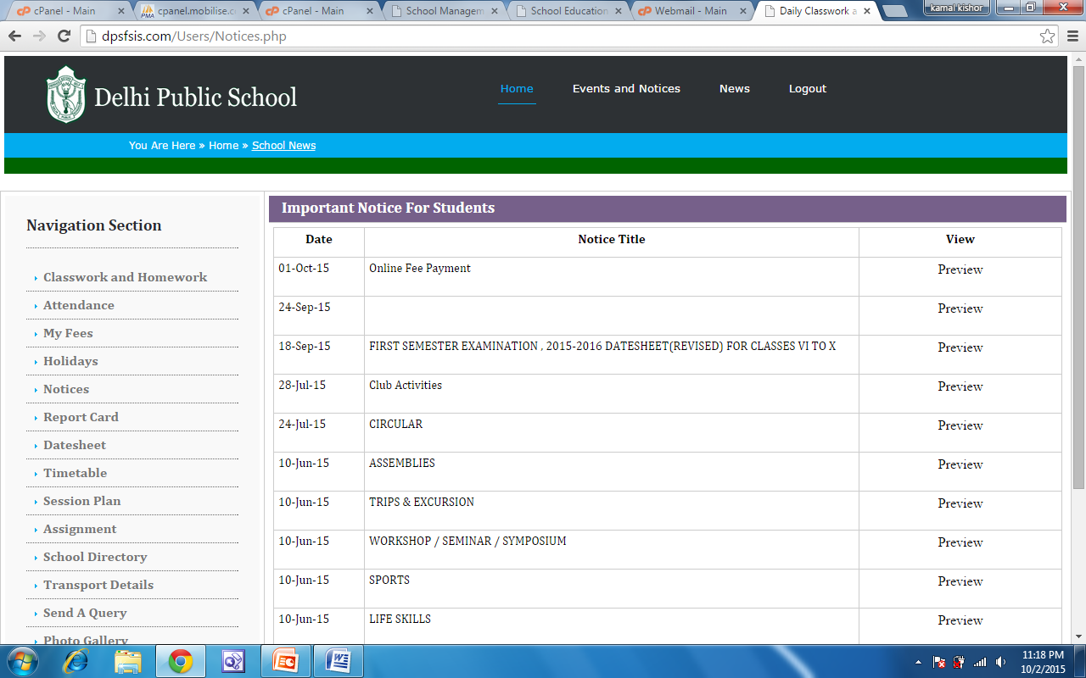
how to use online fees payment facility
Step:2 Click My Fees
Click Hear
Notes:
The organizational benefits of global human resources translate into:
Improves business insight: Embedded and predicitive analytics improves business insight and decision making
Improves compliance: Being able to adapt to constant changing regulations in different countries improves compliance.
Increases Employee Engagement: When HR service delivery is improved, employee engagement increases
Increases Agility: Organizational and complaince changes are constant and an organization needs to be agile to adapt to all these changes
Increases data accuracy: Eliminating disparate HRMS systems and consolidating the HRMS system will decrease maintenance cost and increase data accuracy
Gain operational excellence and compliance with global human resources.

Slide 5
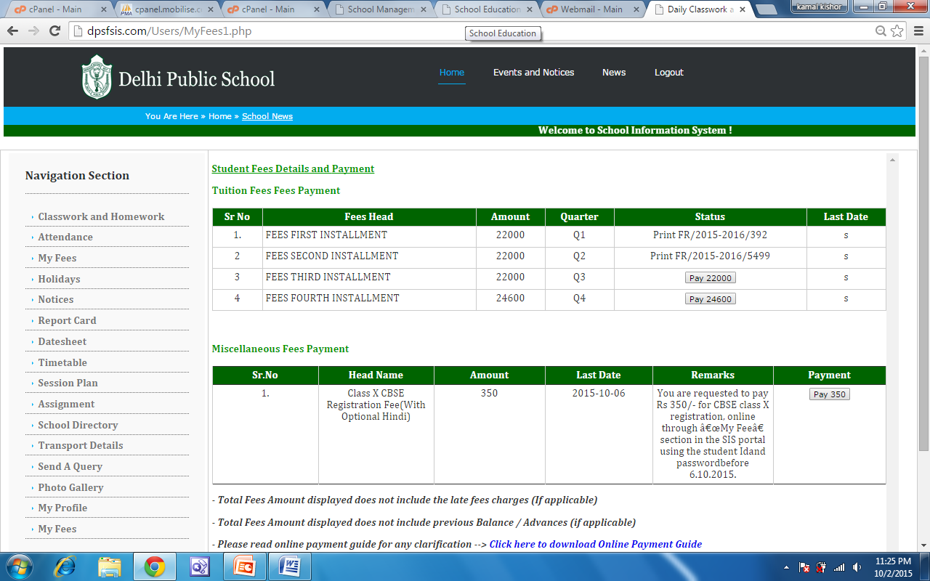
how to use online fees payment facility
Step:3 Click Pay Now Button
Click on Pay Button to pay the fee
Click on Pay Button to pay the Miscellaneous fee
Notes:
The organizational benefits of global human resources translate into:
Improves business insight: Embedded and predicitive analytics improves business insight and decision making
Improves compliance: Being able to adapt to constant changing regulations in different countries improves compliance.
Increases Employee Engagement: When HR service delivery is improved, employee engagement increases
Increases Agility: Organizational and complaince changes are constant and an organization needs to be agile to adapt to all these changes
Increases data accuracy: Eliminating disparate HRMS systems and consolidating the HRMS system will decrease maintenance cost and increase data accuracy
Gain operational excellence and compliance with global human resources.

Slide 6
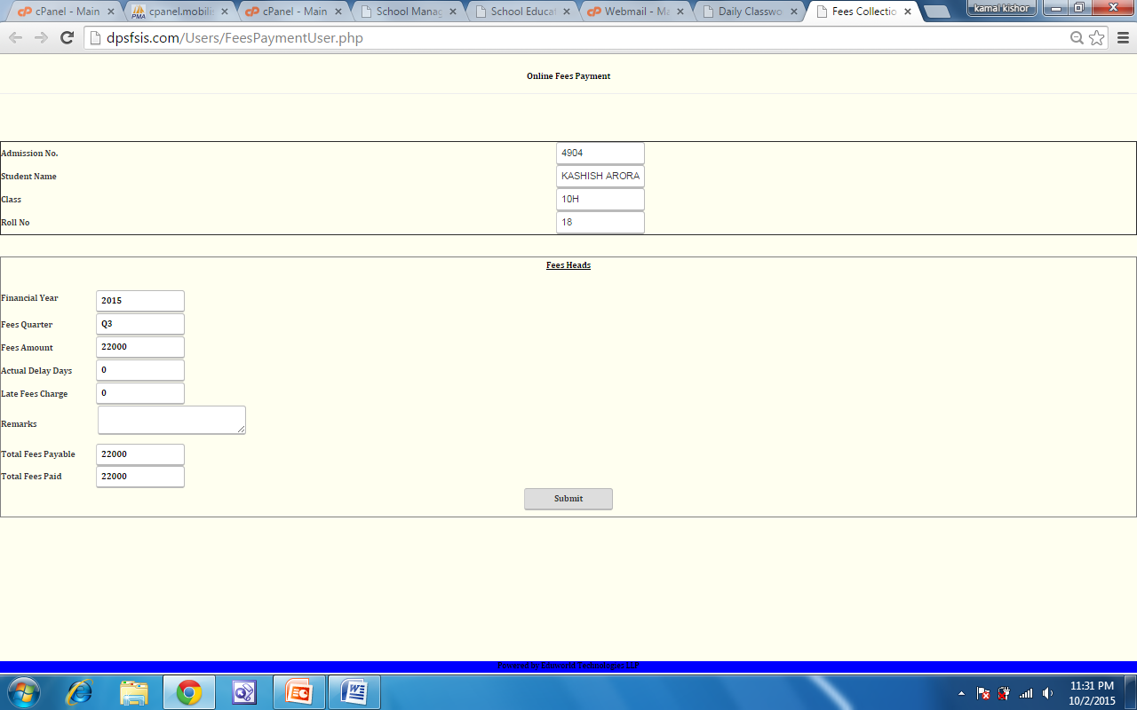
how to use online fees payment facility
Step:4 On this page, you can view the details like, Fees Amount, Late Fees Charges if applicable, and enter a remark while paying fees online.
Please note:
Only VISA / Master card are allowed for payment
Click Here to make payment online
Notes:
The organizational benefits of global human resources translate into:
Improves business insight: Embedded and predicitive analytics improves business insight and decision making
Improves compliance: Being able to adapt to constant changing regulations in different countries improves compliance.
Increases Employee Engagement: When HR service delivery is improved, employee engagement increases
Increases Agility: Organizational and complaince changes are constant and an organization needs to be agile to adapt to all these changes
Increases data accuracy: Eliminating disparate HRMS systems and consolidating the HRMS system will decrease maintenance cost and increase data accuracy
Gain operational excellence and compliance with global human resources.

Slide 7
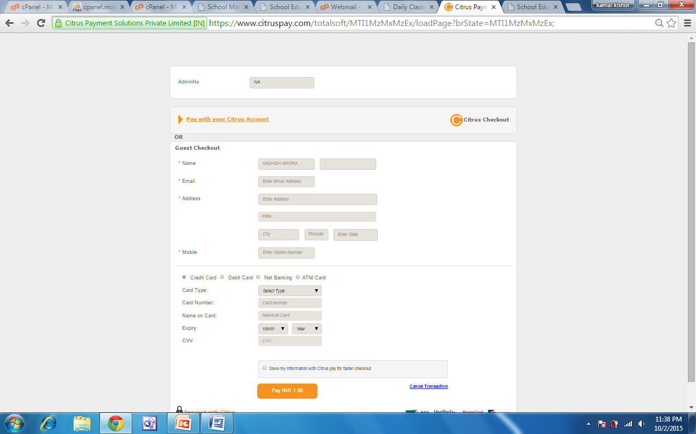
how to use online fees payment facility
Step:5 Go to Citrus payment gateway, fill all detail and click submit Button
Please fill email Id where you want the Receipt of the payment from Payment Gateway.
Click Here to make payment online
Notes:
The organizational benefits of global human resources translate into:
Improves business insight: Embedded and predicitive analytics improves business insight and decision making
Improves compliance: Being able to adapt to constant changing regulations in different countries improves compliance.
Increases Employee Engagement: When HR service delivery is improved, employee engagement increases
Increases Agility: Organizational and complaince changes are constant and an organization needs to be agile to adapt to all these changes
Increases data accuracy: Eliminating disparate HRMS systems and consolidating the HRMS system will decrease maintenance cost and increase data accuracy
Gain operational excellence and compliance with global human resources.

Slide 8
Support Desk
Please write to us at support@onlineschoolplanet.com for any clarifications
Kindly call at School Reception for further details or SIS Team
School Reception
Phone no 0129-2280522,229052
School PRO:
Mobile no 8744078548, 8744078558
Technical Support:
Contact no 9599194332

